Slide 1

Department of Computer Engineering
Sequential Logic Design – Counters
1

Slide 2
Points covered
Department of Computer Engineering
Introduction
Types of registers
2

Slide 3
Department Vision & Mission
Department of Computer Engineering
Vision
Achieve academic excellence through education in computing, to create intellectual manpower to explore professional, higher educational and social opportunities.
Mission
To impart learning by educating students with conceptual knowledge and hands on practices using modern tools, FOSS technologies and competency skills there by igniting the young minds for innovative thinking, professional expertise and research.

Slide 4
Ring Counter
A ring counter takes the serial output of the last Flip-Flop of a shift register and provides it to the serial input of the first Flip-Flop.

Slide 5
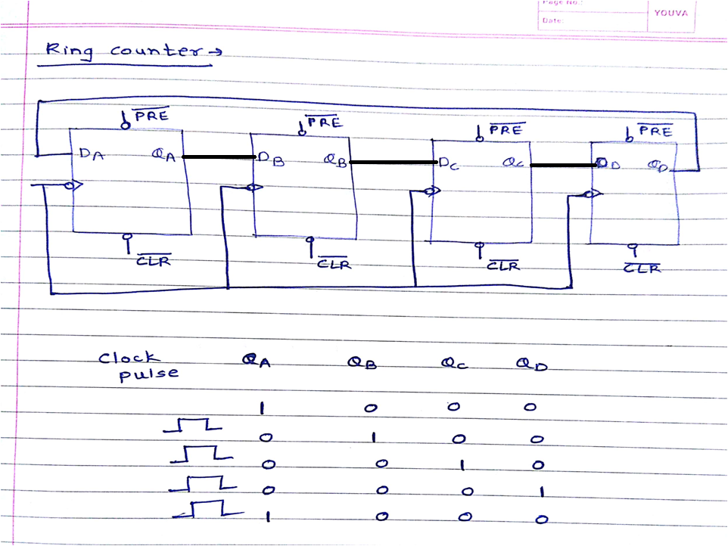
Department of Computer Engineering

Slide 6
Johnson Counter / Twisting Ring / Switch Tail Counter
A Johnson Counter re-circulates the last flip-flop Q (inverted) output back to the input of the first Flip-Flop. It doesn’t require an initialization value, and will provide a predictable output state sequence.

Slide 7
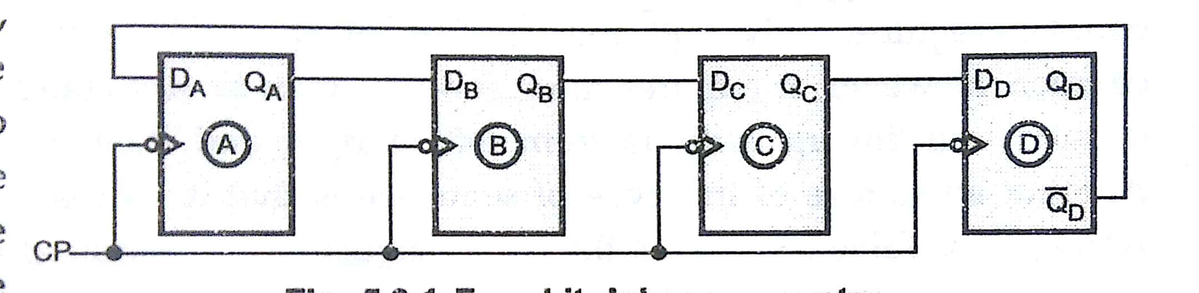
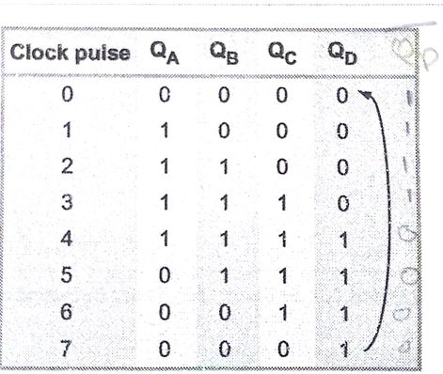
Johnson or Twisting Ring
Counter

Slide 8
Department of Computer Engineering
Thank you

